Slide 1
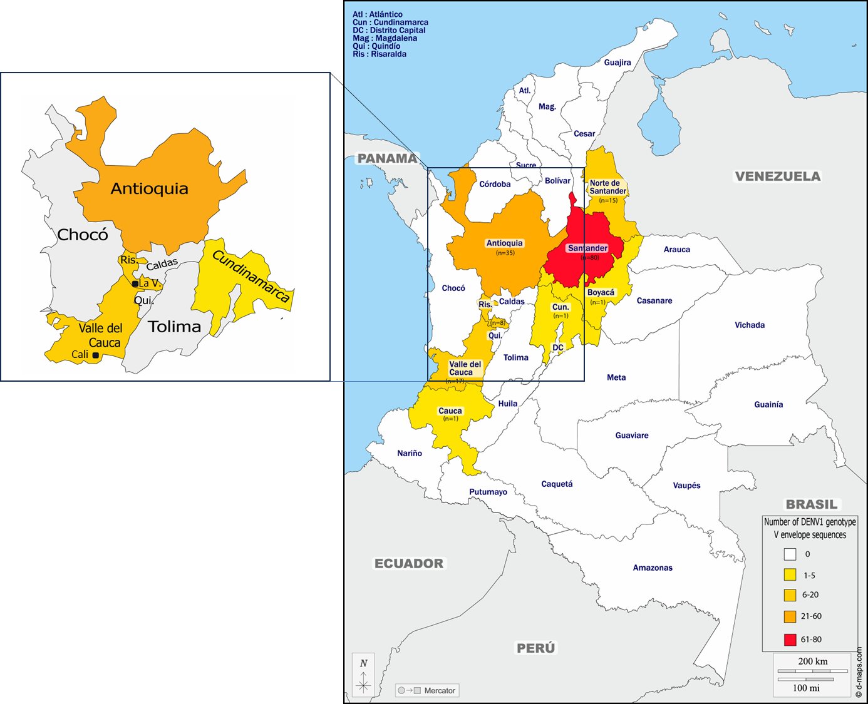
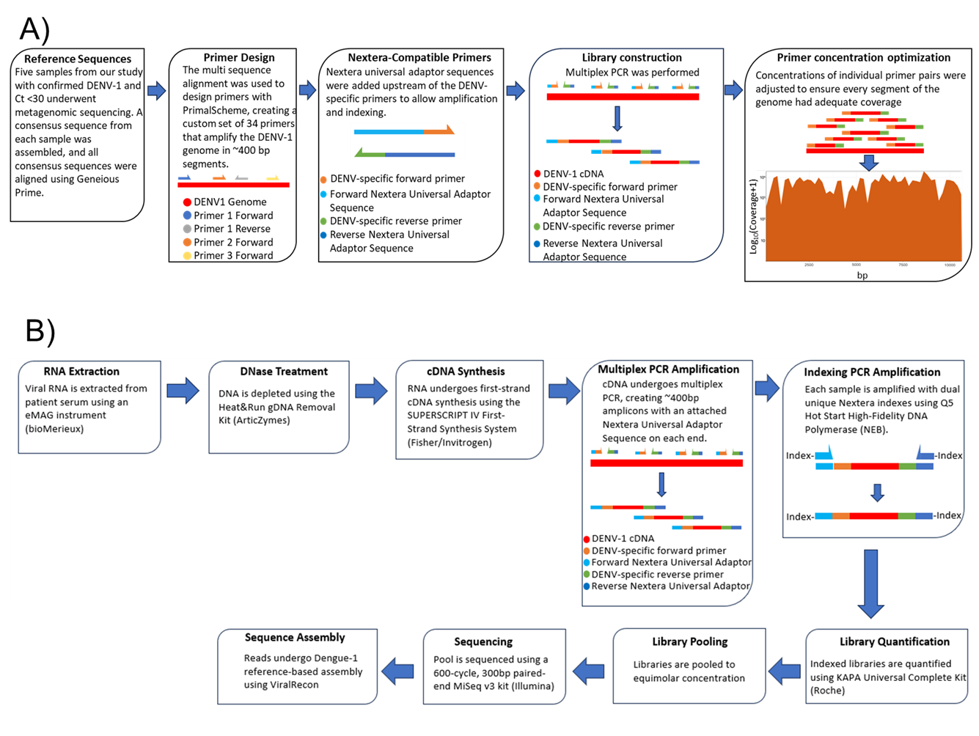
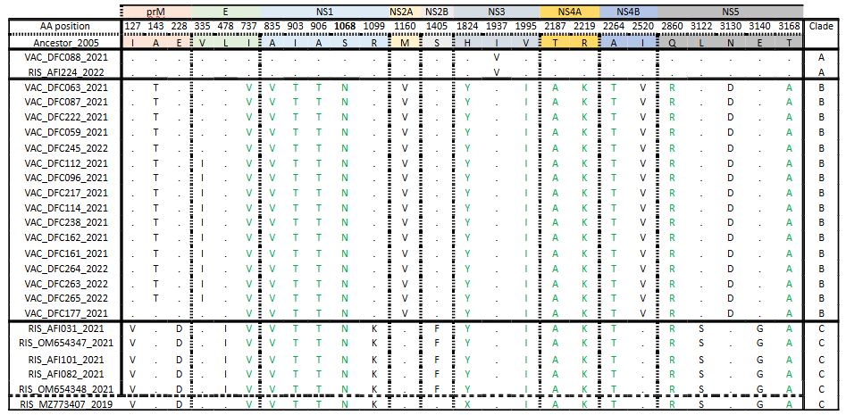
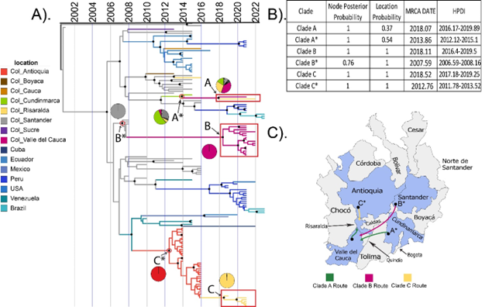
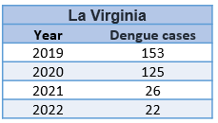
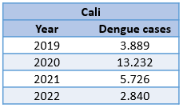
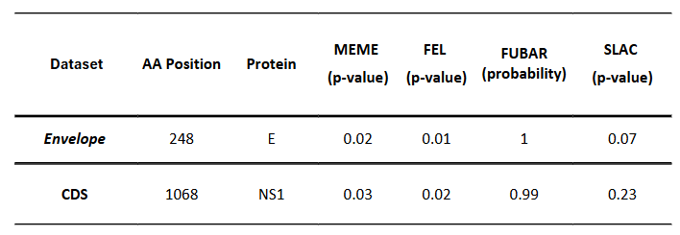
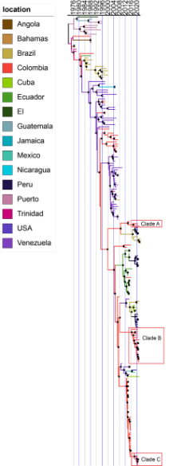
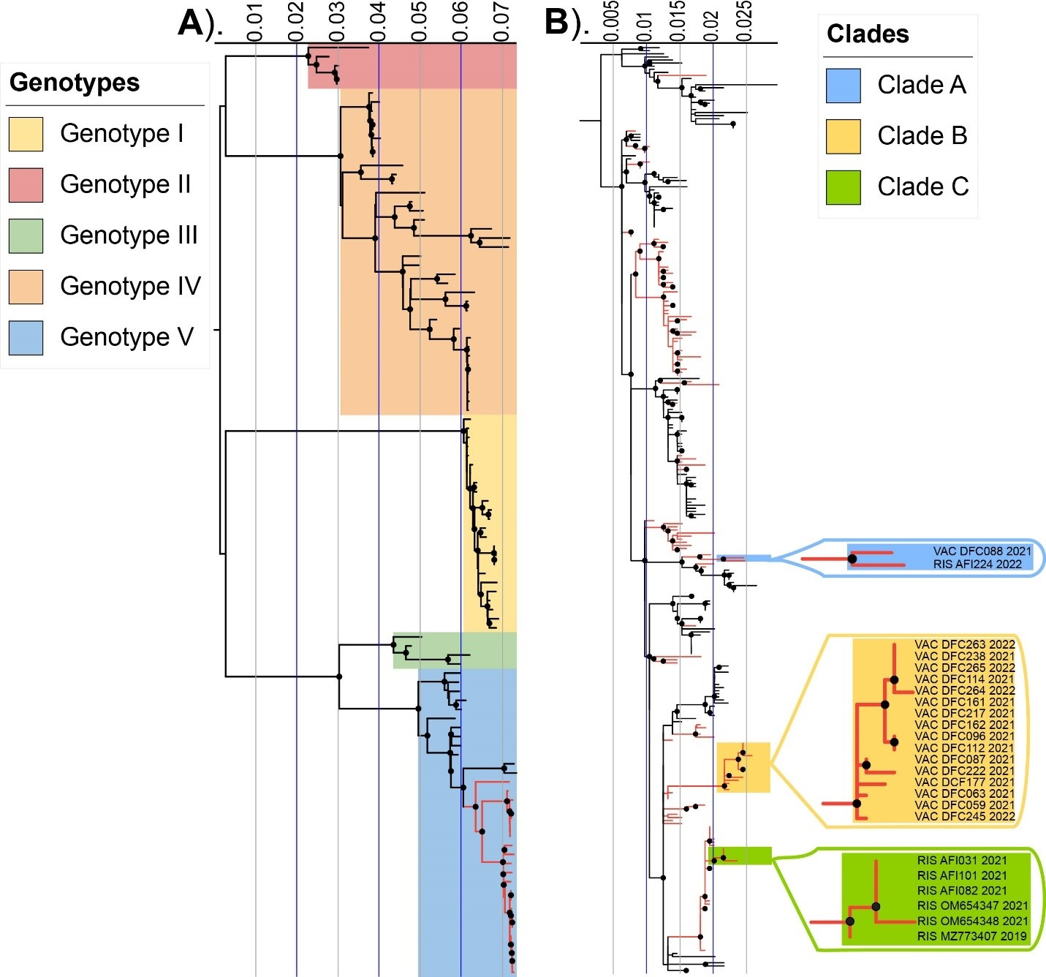
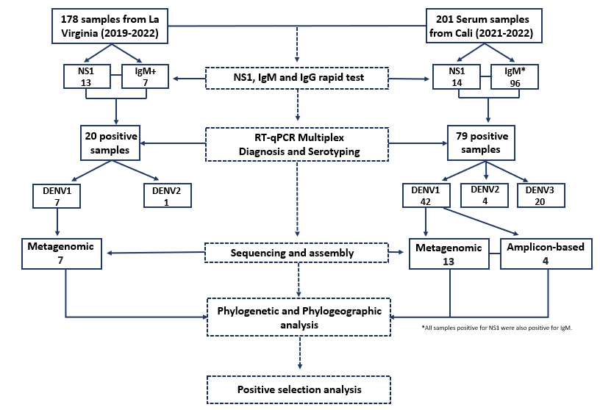
Spatiotemporal dispersion of DENV1 genotype V in western Colombia
Diana Rojas-Gallardo*^{1,2}, Tyshawn Ferrell*³, Paula Escobar⁴, Diego Lopez⁵, Beatriz Giraldo⁵, Juliana Restrepo-Chica⁶, Erika Jimenez-Posada⁶, Marlen Martinez-Gutierrez⁷, Julian Ruiz-Sáenz⁷, Autum Key⁸, Nima Shariatzadeh⁸, Dara Khosravi⁹, Megan A. Martinez¹⁰, Andrei Bombin⁹, Jesse J. Waggoner¹¹, Jorge Osorio¹², Christopher J Neufeldt¹³, Matthew H Collins¹¹, Jaime A. Cardona-Ospina*^{2,14}, Anne Piantadosi*^{8,9}
¹Population Biology, Ecology and Evolution Graduate program, Emory University, Atlanta, GA, USA^{. 2}Grupo de Investigación Biomedicina, Facultad de Medicina, Institución Universitaria Visión de las Américas, Pereira, Colombia. ³Biochemistry, Cell & Developmental Biology Graduate Program, Emory University, Atlanta, GA, USA. ⁴Programa de Química, Facultad de Ciencias Básicas y Tecnologías, Universidad del Quindío, Armenia, Colombia. ⁵Facultad de Ciencias de la Salud, Unidad Central del Valle del Cauca, Tuluá, Colombia. ⁶Instituto para la investigación en Ciencias Biomédicas – Sci-help, Colombia. ⁷Grupo de Investigación en Ciencias Animales, Universidad Cooperativa de Colombia, Bucaramanga, Colombia. ⁸Department of Medicine, Emory University School of Medicine, Atlanta, Georgia, USA. ⁹Department of Pathology and Laboratory Medicine, Emory University School of Medicine, Atlanta, Georgia, USA. ¹⁰Microbiology and Molecular Genetics Graduate Program, Emory University, Atlanta, GA, USA. ¹¹Division of Infectious Diseases, Department of Medicine, Emory University School of Medicine, Atlanta, Georgia, USA. ¹²School of Veterinary Medicine, University of Wisconsin, Madison, WI, USA. ¹³Department of Microbiology and Immunology, Emory University School of Medicine, Atlanta, Georgia, USA. ¹⁴Division of Infectious Diseases and Vaccinology, School of Public Health, University of California, USA.
Introduction
Results
Clade-specific amino acid substitutions occurred across the genome.
Phylogeographic analyses reveal persistence, evolution, and local transmission of DENV1 clades in western Colombia.
Table 2. Amino acid changes observed in newly-generated sequences. The substitutions in black represent clade-specific mutations. Each protein region is color-coded, and the dot represents conserved positions. The dashed line separates the Risaralda 2019 sequence from those found in 2021.
Position 1068 in the B-ladder domain of NS1 is under positive selection
Figure 1 . Geographical location of study sites. Table 1. Number of dengue cases per city in the sampling periods
Figure 3. Amplicon-based sequencing approach. (A) Steps used to create custom primers for multiplex amplicon sequencing of DENV1 genotype V in this study. (B) Laboratory and analysis workflow.
Figure 5. Temporal and geographical analysis of newly-generated DENV sequences. (A) Time-scaled Maximum clade credibility (MCC) tree of 147 DENV1 genotype V envelope sequences, including the 24 newly-generated sequences, highlighted with red boxes. Circles indicate nodes with a posterior probability of 90% or greater. Branches are colored by location or inferred location, and pie charts indicate the posterior location probability for each node of interest. Location nomenclature for Colombian sequences includes Col_ and the department name. (B) Posterior probability of the node position, location probability and date with 95% highest posterior density (HPD). (C) Dispersion of clades identified in this study
DENV is endemic to tropical and subtropical areas within South America, especially in Colombia. Recent studies have identified several factors that influence DENV circulation and diversity in Colombia, including the introduction of new DENV lineages and clades from neighboring countries, ongoing co-circulation of multiple serotypes, and in-situ evolution. However, the epidemiological and phylogeographic distribution of DENV in Colombia is unclear especially in the western regions of Colombia, where large outbreaks have occurred.
Here, we investigate the origin, genetic diversity, and spatiotemporal dispersion of DENV1 genotype V in two departments that had different disease burdens during the most recent outbreak in 2019.
Results
Phylogenetic analysis reveals unique regional clades of DENV1 Genotype V. space for add more information if needed
Table 3. Positive selection analysis for DENV1 genotype V sequences from Colombia. Observed positions under positive selection in the envelope (n=300) and CDS (n=209) datasets. Selection analysis was implemented using models from HyPhy.
Conclusions
Different DENV serotypes co-circulated in the cities, in La Virginia DENV2-III and DENV1-V circulated, while in Cali, DENV2-III, DENV3III and DENV1-V.
Contemporary DENV1 genotype V viruses are descendant from viruses that have been circulating in Colombia over the last 15 years.
Co-circulation of multiple DENV1 genotype V clades in nearby geographic regions were observed.
Clade-specific mutations were found, some of which may have a role in immune evasion or pathogenesis.
Amplicon-based sequencing was a successful method to generate complete genomes in samples with high Ct values
Methods
References
Muñoz, E., et al., Spatiotemporal dynamics of dengue in Colombia in relation to the combined effects of local climate and ENSO. Acta Tropica, 2021. 224: p. 106136.
Salvo, M.A., et al., Tracking dengue virus type 1 genetic diversity during lineage replacement in an hyperendemic area in Colombia. Plos one, 2019. 14(3): p. e0212947.
Laiton-Donato, K., et al., Molecular characterization of dengue virus reveals regional diversification of serotype 2 in Colombia. Virology journal, 2019. 16: p. 1-7.
Carrillo-Hernandez, M.Y., et al., Phylogenetic and evolutionary analysis of dengue virus serotypes circulating at the Colombian–Venezuelan border during 2015–2016 and 2018–2019. PLoS One, 2021. 16(5): p. e0252379.
Jiménez-Silva, C.L., et al., Evolutionary history and spatio-temporal dynamics of dengue virus serotypes in an endemic region of Colombia. PloS one, 2018. 13(8): p. e0203090.
Figure 6. ime-scaled Maximum clade credibility (MCC) tree of 209 full-length DENV1 genotype V CDS sequences, including 24 newly-generated sequences. Sequences highlighted in red were identified in this study, while other sequences were obtained from GenBank. Branch colors are based on the location of the isolated virus samples and inferred probable posterior location of its ancestors.
Acknowledgements
Figure 4. Maximum-likelihood phylogenetic analyses newly-generated DENV1 sequences. The black circles on each node represent an ultrafast bootstrap value greater than or equal to 95, and the internal tree scale represents the nucleotide substitutions per site. (A) Full-length representative sequences (n=103) from each DENV1 genotype. The Colombian sequences identified in this study are highlighted in red. (B) Downsampled ML tree of 300 DENV1 genotype V envelope sequences. All sequences from Colombia are highlighted in red. The newly-generated sequences grouped into three distinct clades.
We thank Dr. Daniel Espinoza for logistical support.
Funding
JA and DR received funding support from Minciencias project: 799784467706.
TF received funding support from The National GEM Consortium and Emory University’s Centennial fellowship.
DR received funding from Fulbright-Minciencias Graduate Scholarship.
BG a d DL received founding from UCEVA project: PI-1300-50.2-2022-09.
Figure 2. Methodological process diagram.

